Slide 1
Digital Video Compression: A Primer for Law Enforcement
Howdy Pierce Managing Partner
August 25, 2011
A copy of this presentation is available at www.cardinalpeak.com/DSI-2011.html
Notes:
How Digital Video Compression Works: A Primer for Law Enforcement
How does digital video compression work? How are predicted video frames computed? What does it mean that compression is "lossy," anyway? Howdy Pierce, Managing Partner at Cardinal Peak, will address the theory behind video compression. This discussion will also address questions about reliability of digital evidence and how to explain your digital evidence in court. Mr. Pierce has been involved in designing digital media compression systems since 1995 and has deep technical expertise.

Slide 2
About Me
I’m a software engineer!
… and therefore not a lawyer
I’ve been working on digital media compression since 1995
Primarily video compression
Managing Partner of Cardinal Peak
Manufacturer of CaseCracker Interview Management system, used to digitally record custodial interrogations

Slide 3
Overview
Overview of how image and video compression works
Discussion of issues specific to law enforcement

Slide 4
The take-home message
There is unnecessary fear around digital video compression when used in a legal setting
Technical terms like “lossiness” and “prediction” have caused a PR problem!
These terms have precise technical meaning that differs from their everyday meaning
They are not scary concepts
Bottom line:
Digital video compression works
Nobody finds someone else’s kids in their vacation videos!

Slide 5
Time to get Nerdy!
How does compression WORK?

Slide 6
Disclaimer
“Teaching is like telling a smaller lie every day.”
– some guy on the Internet
I’ve simplified a lot in what follows
Trying to strip the concepts down to the essentials
Reality is more complex, but not in ways that really matter

Slide 7
Analog Signal
A signal is represented by a continuous waveform
Nature is analog!
It’s difficult to store, transmit, search analog signals
Examples of analog media:
Old-fashioned “analog” TV, and VCR tapes (video) Film (photos) Records and cassette tapes (audio)

Slide 8
Digital Signal
A signal can be turned into numbers by sampling:
The more frequent the samples, the closer the digital representation will match the original analog signal
With sufficient sampling frequency, this is normally considered to be a loss-less process
Examples of uncompressed digital media include
CDs (audio) RAW images from DSLRs (photos)
7 8 9 10 10 8 4 1 -1 1 5 …

Slide 9
Digital Compression
Uncompressed digital files are HUGE!
100 MB = < 10 minutes of CD-quality audio = < 7 “five-megapixel” images = < 7 seconds of standard def video
To make storage and transmission economical, compression ratios of 100-to-1 (or more!) are needed
In order to achieve these ratios, lossy compression is used
Examples of compressed digital media include
JPEGs (images) MP3 and AAC files (audio) HDTV, Blu-ray, DVD (video) Cell phone calls (audio)
Notes:
We use lossy algorithms every day

Slide 10
What does “Lossiness” Mean?
A compression algorithm is “lossy” if you don’t get back exactly the same thing you put in:
With modern algorithms, the lossiness is usually not noticeable, subjectively
Digital Source File
Digital Output File
Encoding (Compression)
Decoding (Decompression)

Slide 11
Where does lossiness happen?
4 areas where lossiness enters the picture:
Resolution Reduction (not always) | Changing (for instance) a 640x480 image into a 320x240 image
Chroma Sub-Sampling | The human eye is not equally sensitive to luminance and chrominance changes, so chroma is normally subsampled (“4:2:0”)
Pre-filtering (not always) | Many encoders filter out noise in the image, prior to compression, in order to make compression more efficient
Quantization | Caused by rounding during the encoding process, this is probably the hardest to understand – and we will cover it further!

Slide 12
Common Open-Standard Codecs
 | Audio | Image | Video
Lossless | PCM, uLaw*, G.711 | “RAW”
Lossy | MP3 | JPEG | Motion JPEG
 | WMA |  | WMV
 | AAC |  | MPEG-2
 |  |  | MPEG-4
 |  |  | H.264

Slide 13
Video and Image Compression
Most common forms of video and image compression have the same central concept
JPEG and “motion JPEG”
MPEG-1
MPEG-2
MPEG-4
H.264
Obviously, there are differences too
The MPEG and H.264 use inter-frame prediction, which we will address later

Slide 14
Video and Image Compression
8x8 block

Slide 15
Video and Image Compression
8x8 block
101 | 100 | 94 | 102 | 97 | 91 | 88 | 83
101 | 99 | 98 | 103 | 93 | 93 | 107 | 110
98 | 97 | 97 | 97 | 103 | 101 | 94 | 100
97 | 98 | 99 | 100 | 103 | 105 | 101 | 96
99 | 100 | 104 | 104 | 100 | 107 | 109 | 89
99 | 101 | 106 | 105 | 116 | 113 | 87 | 58
94 | 69 | 70 | 66 | 79 | 70 | 40 | 26
59 | 30 | 27 | 33 | 32 | 37 | 45 | 41
Source Matrix

Slide 16
How Many Bits?
Source Matrix
How many bits should it take to code this block?
The naïve answer:
8 × 8 = 64 values, at 8 bits each, or 512 bits

Slide 17
3 Key Steps of Image Compression
DCT
Quantization
Entropy Coding
8x8
block
coded data
Discrete Cosine Transform
Quantization
Entropy Coding

Slide 18
Discrete Cosine Transform
Transforms one matrix into another matrix
Reversible & lossless
The transformed matrix has some interesting properties
Most information represented in the low-order coefficients

Slide 19
Discrete Cosine Transform
Source Matrix
DCT
Increasingly higher frequencies in horizontal domain
the “DC coefficient”
(avg of initial matrix)
Increasingly higher frequencies in vertical domain
DCT Coefficients

Slide 20
3 Key Steps of Image Compression
DCT
Quantization
Entropy Coding
8x8
block
coded data
Discrete Cosine Transform
Quantization
Entropy Coding

Slide 21
Quantization
256
Quantization is the lossy step in image compression
Instead of using 8 bits to accurately represent values on the original line…
…we round the values to the nearest plateau, and then represent this in 4 bits.
But we’ve lost the ability to accurately reconstruct the original values, because of rounding!
0

Slide 22
Why quantization is OK
66%
69%
In practice, human perception is not that precise!
We can tolerate some rounding without noticing
Even if quantization becomes noticeable, it doesn’t change how we interpret the image

Slide 23
After Quantizing
DCT Coefficients
Quantization
This is the data we need to transmit to the decoder
Quantized with MPEG-2 weighting matrix and scale=8

Slide 24
Reversing the Process
Original Source Matrix
Recovered Output (q=8)
DCT
Quantization
(q=8)
Inverse Quantization
Inverse DCT

Slide 25
How Lossy Is It?
Original Source Matrix
Recovered Output (q=8)
Error Matrix
Sum of Squares of error matrix: 4335

Slide 26
How Lossy Is It?
Original Source Matrix
Recovered Output (q=8)

Slide 27
3 Key Steps of Image Compression
DCT
Quantization
Entropy Coding
8x8
block
coded data
Discrete Cosine Transform
Quantization
Entropy Coding

Slide 28
Run-Length Coding
Quantized data with MPEG-2 weighting matrix and scale=8
Apply a zig-zag scan pattern:
86, 1, 7, 5, -1, 0, 1, 0, 0, 2, -1, 1, 0, -1, 0, 0, 0, 0, -1, 0, 0, …
Note that there are a lot of runs of zeros!
Break into “words” of X zeros, followed by a coefficient

Slide 29
Run-Length Coding
86, 1, 7, 5, -1, 0, 1, 0, 0, 2, -1, 1, 0, -1, 0, 0, 0, 0, -1, 0, 0, …
The DC coefficient (86) is sent directly = 8 bits
Remaining coefficients are sent as 10 “words”, plus a special end-of-block word

Slide 30
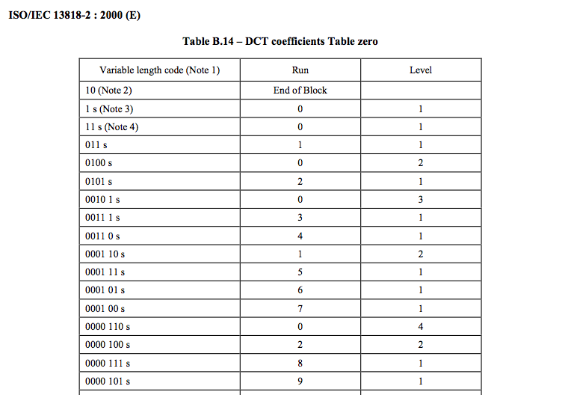
MPEG-2 Huffman Table

Slide 31
Run-Length Coding
Applying the MPEG-2 Huffman code to this set of words, we consume 52 bits
So, we code the entire 8x8 block in 60 bits!

Slide 32
To Recap…
Everything we’ve discussed until now is applicable to both video and still images
These techniques take advantage of spatial redundancy – the likelihood that pixels are similar to their neighbors
In video, there is also temporal redundancy
The likelihood that pixels are similar to previous & successive frames
The term for what I’m about to discuss is motion compensation – also known as prediction

Slide 33
Here’s an example

Slide 34
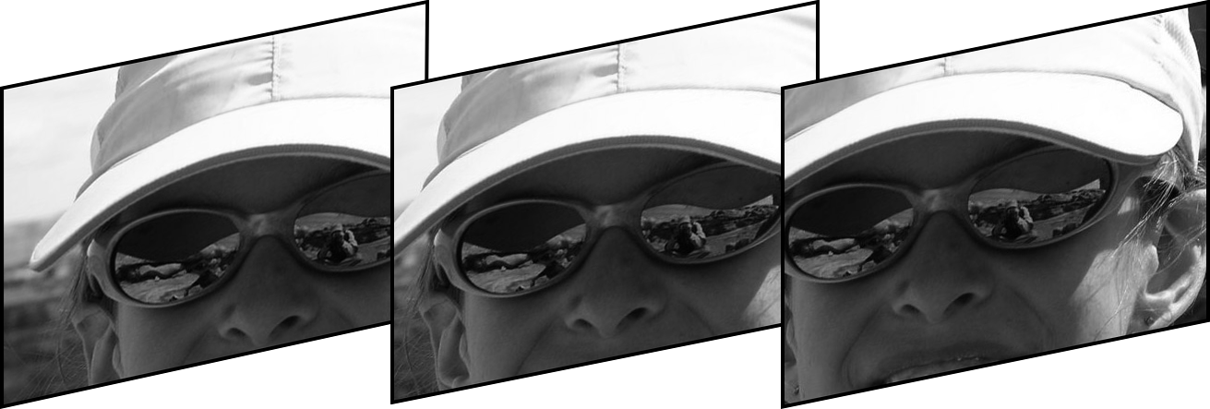
Video basics
Video is a succession of images
Normally displayed at 30 frames per second in the US
Similar blocks tend to appear in successive images
Not always identical
Not always in the same place

Slide 35
Motion Compensated Prediction
We can save bits by
Sending the offset, as a vector (the “prediction”)
Coding the difference between the predicted & actual blocks
If the prediction is good, then the difference matrix is made up of small numbers
Therefore it shouldn’t require too many bits to send

Slide 36
The Difference Matrix
The “difference” between the predicted and actual blocks is (again) a matrix
This difference is coded just like the original picture:
Thus, there is again imprecision owing to quantization
DCT
Quantization
Entropy Coding
difference
block
coded data

Slide 37
More vocabulary: I, P, and B frames
MPEG introduced the concept of I, P, and B frames
In H.264 this has mostly been obsoleted by even more complexity
INTRA “I frames” | Coded just like a JPEG, without reference to other frames Useful to allow random access into video
PREDICTED “P frames” | Each block can be intra-coded, or can be predicted by a block from a previous frame
BI-DIRECTIONAL PREDICTED “B frames” | Blocks can be intra-coded, or can be predicted by a block in a previous or succeeding frame

Slide 38
Overview
Overview of how image and video compression works
Discussion of issues specific to law enforcement

Slide 39
Issues for Law Enforcement
Three issues arise with digital compressed media:
How to prove that digital evidence depicts “reality” when it has been compressed with a lossy algorithm?
How to prove that a particular digital file has not been altered since the time of capture?
How to ensure that my files will be readable in 5, 10, 20 years?

Slide 40
Fear, Uncertainty, Doubt: Lossiness
As a society we are getting used to lossy compression:
DVDs
MP3s / iPods
Digital point-and-shoot cameras
The legal question:
Whether a digital file accurately depicts what happened!
So we need to set up systems where we can testify that the file is indeed an accurate depiction

Slide 41
Fear, Uncertainty, Doubt: Lossiness
Federal Rules of Evidence, Article X (Contents of Writings, Recordings and Photographs), Rule 101(1) defines writings and recordings to include magnetic, mechanical or electronic recordings. Rule 101(3) states that if data are stored in a computer or similar device, any printout or other output readable by sight, shown to reflect the data accurately, is an "original". Rule 101(4) states that a duplicate is a counterpart produced by the same impression as the original…by mechanical or electronic re-recording, … or by other equivalent techniques which accurately reproduces the original. And Rule 103 (Admissibility of Duplicates) states a duplicate is admissible to the same extent as an original unless (1) a genuine question is raised as to the authenticity of the original or (2) in the circumstances it would be unfair to admit the duplicate in lieu of the original.
—Staggs, Steven B., “The Admissibility of Digital Photographs in Court”, http://www.crime-scene-investigator.net/admissibilityofdigital.html

Slide 42
Was a digital file altered?
How to prove that a digital file hasn’t been altered after recording
Some vendors (including Cardinal Peak!) offer “checksums” to “prove” that a file hasn’t been altered
These checksums may be helpful but are relatively easy to defeat, and should not be relied on
The only full solution:
Keep your original file in a reliable archive
Ensure that the chain of custody is preserved!

Slide 43
Why checksum systems are oversold
All checksum systems rely on some variation of the following:
Clock Reference
Digital Source File
Magic Formula
Checksum
The problem is that all systems are only as secure as control over the highlighted sections
…and the highlighted sections are in the physical control of the user – meaning YOU – thus subject to hacking

Slide 44
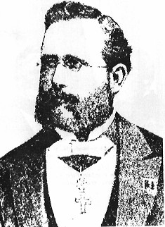
Why checksum systems are oversold
Kerckhoff’s Principle is a fundamental axiom of cryptography:
“A cryptosystem should be secure even if everything about the system, except the key, is public knowledge.”
Checksum systems violate the principle in two ways:
They rely on keeping the “Magic Formula” secret
The key is necessarily stored on the device performing the checksum, and thus discoverable
Auguste Kerckhoffs (1835-1903)

Slide 45
Open Standards
The area of digital media is mostly based on open standards
An Open Standard is one that any vendor can gain access to, on a level playing field
If license fees are involved, they need to be fair
Customers should prefer open standards
Prevents lock-in to a single vendor
Increases likelihood that files will be readable years into the future

Slide 46
Take Away Lessons
Ensure the continuous possession of the unaltered digital file using standard chain of custody procedures
Be able to testify that the digital recording represents a true and accurate version of what really happened
Record important files redundantly, and make sure they are coded using widely available, open file formats

Slide 47
Going back to our three issues…
How to prove that digital evidence depicts “reality” when compressed with a lossy algorithm?
Testify to the true and accurate nature of the recording
How to prove that a particular digital file has not been altered since the time of capture?
Continuous possession / chain of custody
Possibly supported by checksum, but don’t count on it!
How to ensure that my files will be readable in 5, 10, 20 years?
Keep redundant copies
Use open standards

Slide 48
Thank You!
A copy of this presentation is available at www.cardinalpeak.com/DSI-2011.html
Copyright © 2011, Cardinal Peak, LLC
Notes:
How does digital media compression work? What are the differences between codecs such as JPEG, MPEG-2, and H.264? What does it mean that compression is "lossy," anyway? Howdy Pierce, Managing Partner at Cardinal Peak, will address the theory behind the compression of still images, audio, and video, and what you need to know to properly manage your digital evidence. This discussion will also address questions about reliability of digital evidence and how to explain your digital evidence in court. Mr. Pierce has been involved in designing digital media compression systems since 1995 and has deep technical expertise.

